Slide 1
Advanced Software Engineering Seminar
Presented By:
Kawthar Abu Esmail
Meshi Kroitoro
Yarin Tzidon
Mohamed Igbaria

Slide 2
Research Question
Do repositories owned by users with a high number of followers have a higher chance of getting forked?

Slide 3
Research Question Properties and Importance
Properties
This question comes to test if there is a correlation between the number of followers a user has and the chance that the user’s repositories get forked.
The result of the question will give us an indication whether users regarded as “known”, meaning they have many followers, have a higher chance for their repositories to get forked.
Importance
The result of the research will give insight on whether users regard repositories owned by users with a higher number of followers are better than other repositories.

Slide 4
Research Method - Background
In order to answer the research question, we are proposing the use of Statistical analysis in order to find a corelation between two quantitative measures by using A scatter plot graph.
A scatter plot uses dots to represent values for two different numeric variables. The position of each dot on the horizontal and vertical axis indicates values for an individual data point. Scatter plots are used to observe relationships between variables.
(trendline helps to see corelation -A trend line is a straight line that best represents the points on a scatterplot. The trend line may go through some points but need not go through them all. The trend line is used to show the pattern of the data. This trend line may show a positive trend or a negative trend.
)

Slide 5

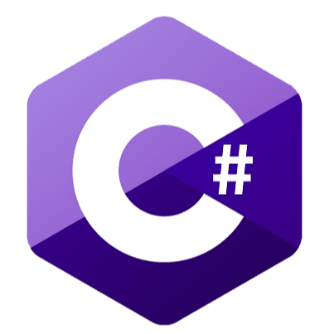

Tools Used during research
GitHub API
C#
Tableau
Used in order to collect Data
Used to perform requests from GitHub API in order to collect data
Used for manual Data Analysis

Slide 6
Dataset
In order to answer the research question, we used the course’s website to find a dataset containing different users.
The original Dataset contain more than 31000 records and doesn’t have information about number of follower of the owner of the repository
Using C# code and GitHub API we add the needed information.

Slide 7
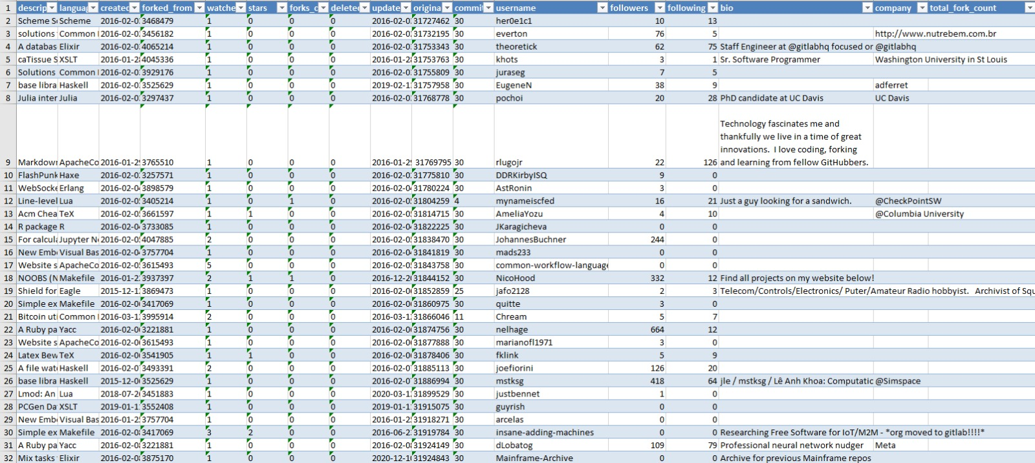
Dataset

Slide 8
Preprocessing
In our research question we are investigating the user’s followers, therefore, we decided to remove all the duplicate user from the original dataset and remove all the repositories with 0 forks using C# before starting analysis.
We Used GitHub User Information API in order to obtain the followers and more relevant data set as:
Username
Bio
Company
Followers
The dataset we ended up with contains 967 records ( different users )

Slide 9
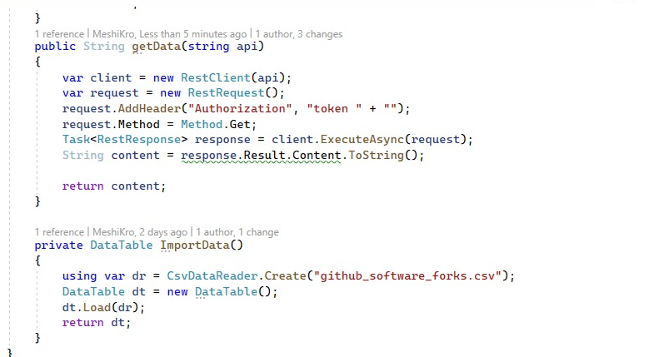
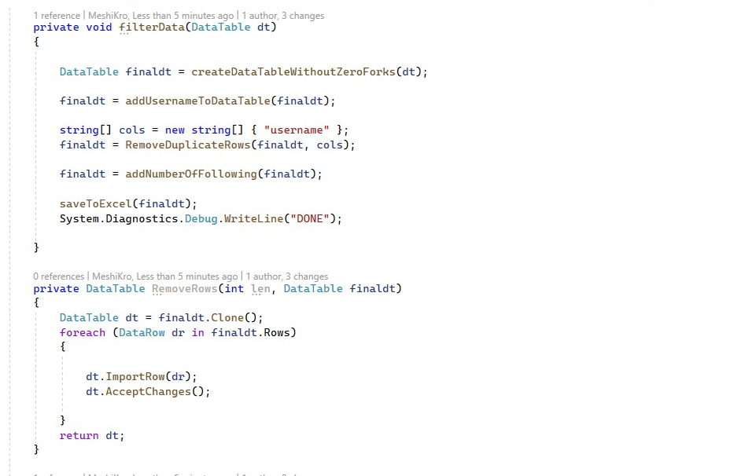
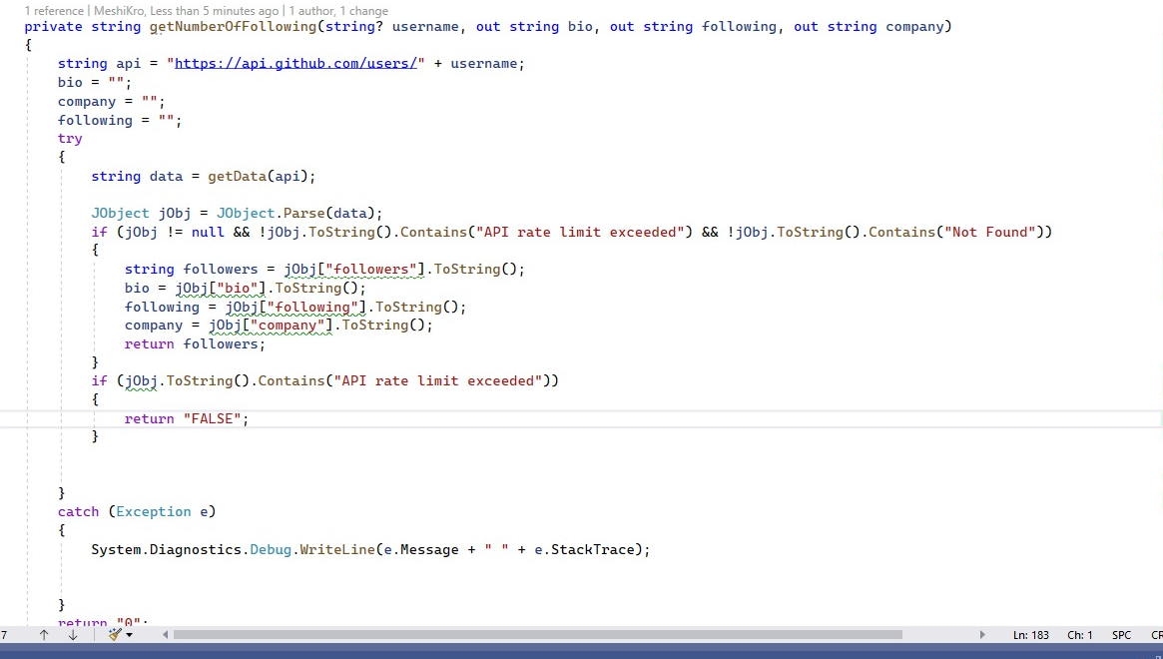

Slide 10
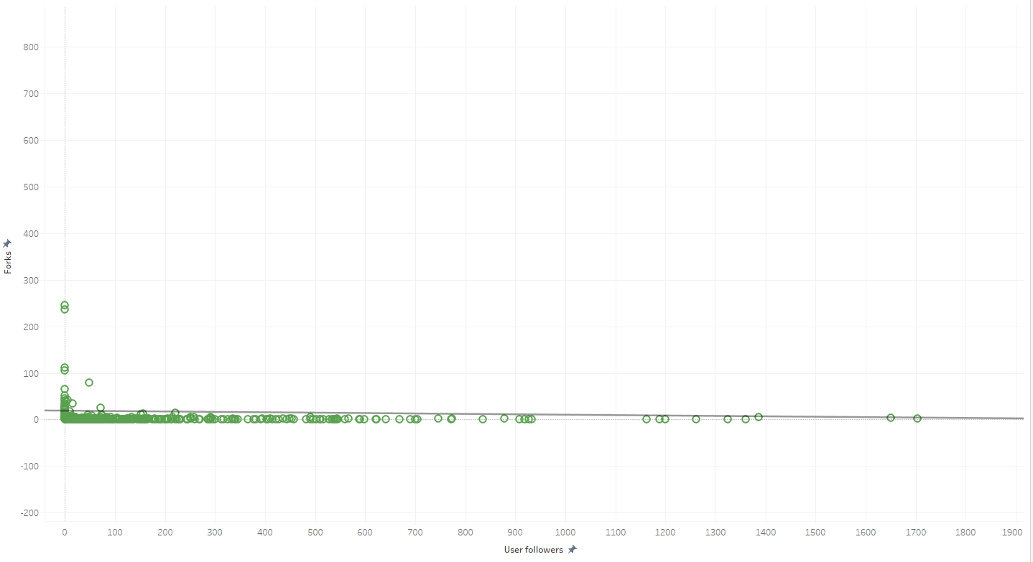
Results - Scatter Plot

Slide 11
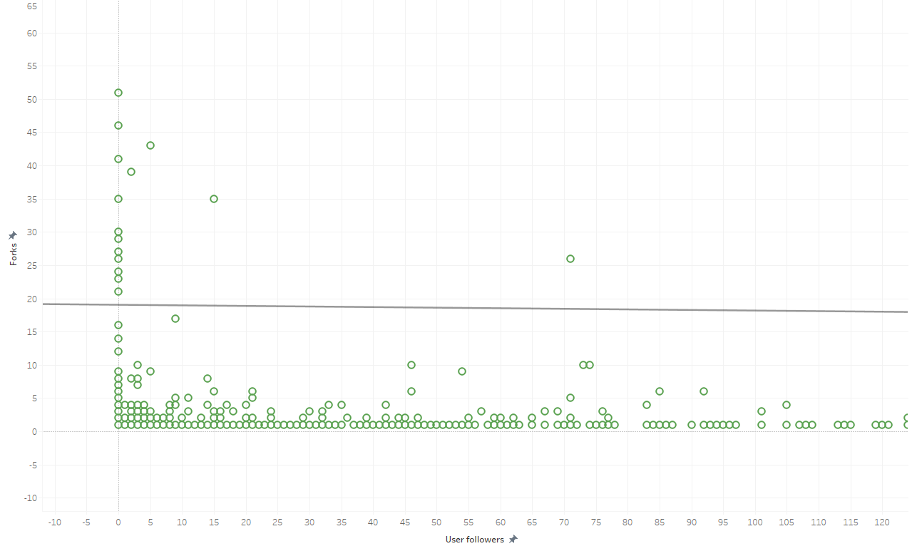
Results - Scatter Plot zoomed-in

Slide 12
Results
After examining at the scatter plot graph, we can see that there isn’t a clear correlation between the number of followers a user has and the amount of forks the user’s repositories received.
We can also see that many users with low number of followers has a very high number of forks and many users with high number of followers has a very low number of forks
The results were not as we expected. we believe that the number of forks a repository has been affected by multiple variables, and it seems that the number of followers a user has is not one of these variables.

Slide 13
Conclusion
There isn’t a correlation between the number of followers a user has and the amount of forks the user’s repositories received.
It seems that users don’t regard repositories owned by users with a higher number of followers better than other repositories. Users tend to look at the repository and not at the user reputation.

Slide 14
Challenges
Finding an interesting research question
Finding a relevant dataset
Learning to use GitHub API
GitHub API has limitations for 5000 calls per hours and 80 calls per minute. In order to overcome this, we used personal token that allowed unlimited access into GitHub API
Deciding on which tools to use for data analysis
Analysing the dataset to answer research question

Slide 15
Lessons Learned
How to develop a research question
How to use GitHub API
How to handle large datasets

Slide 16
Limitations
Our research question was to check if there's a correlation between the subscriber count a user has on YouTube and the amount of forks their repositories have, but we didn’t find a dataset that satisfied our need.
Time limit to check more datasets and validate the results
Having to learn new tools to perform the research

Slide 17
Further Research
Find more datasets with different users to validate the results
//A deeper mathematical analysis on the results we received
Finding what other variables affect the number of forks a repository has
On a set of users who have active YouTube accounts, check if there is a correlation between the number of subscribers they have and the number of forks their repositories receive

Slide 18
Thank you!

